Slide 1
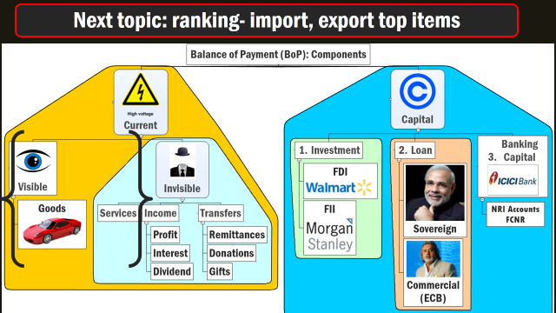
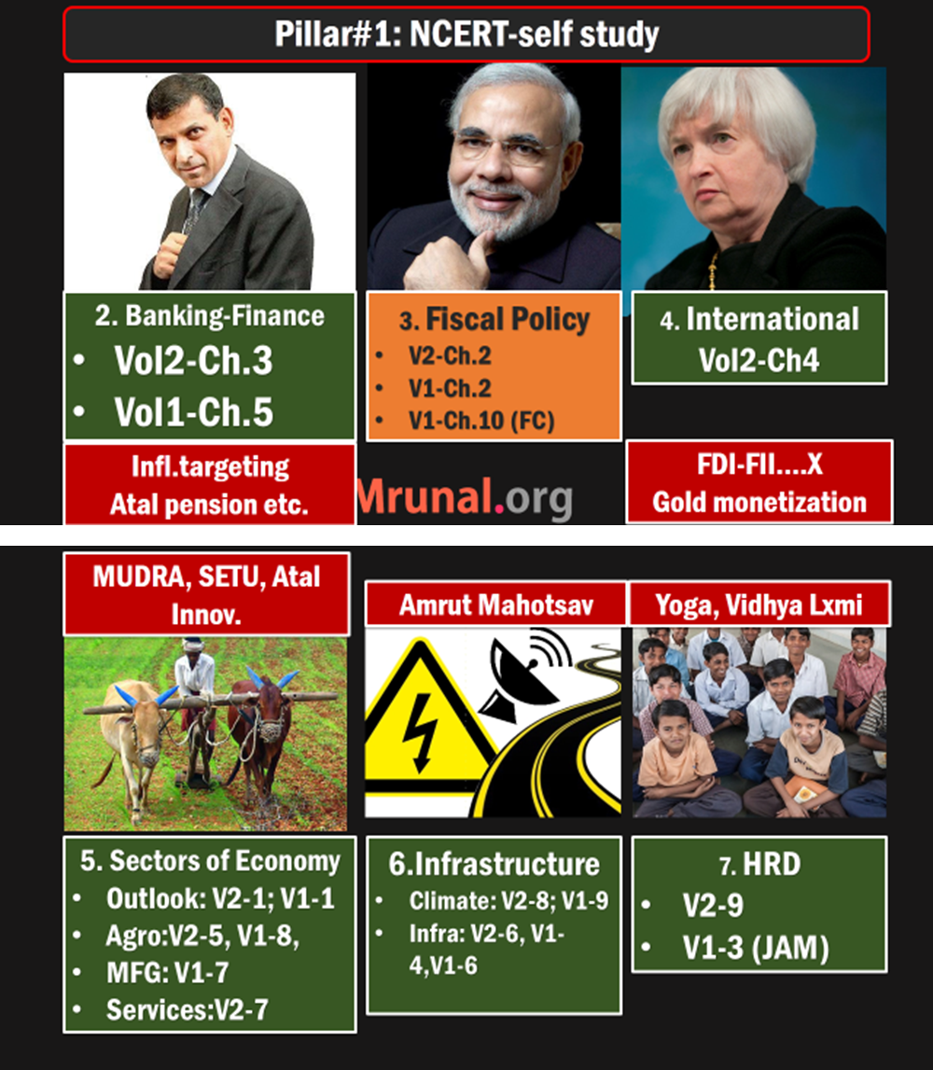

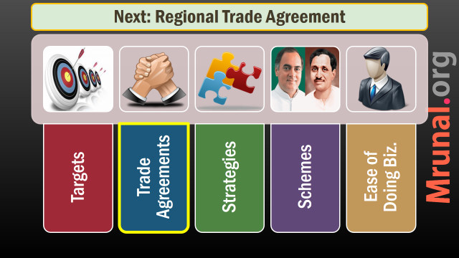

Slide 2
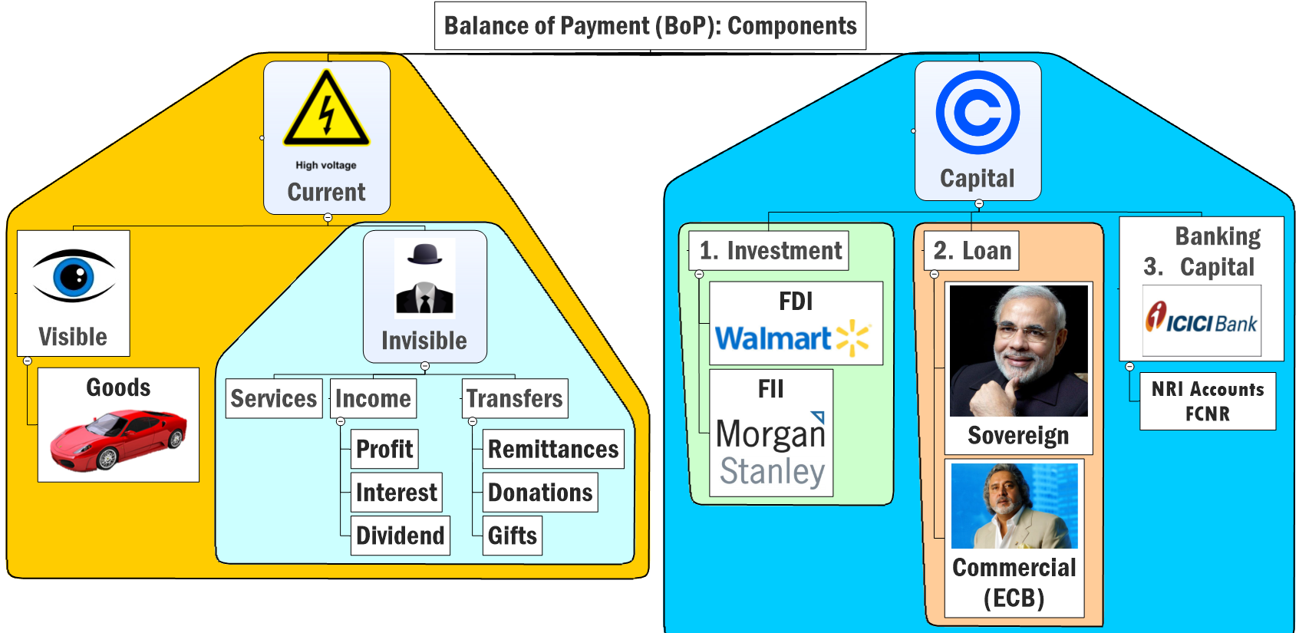
Current Account Deficit

Slide 3
Capital Account: L3/P1, P2

Slide 4
Capital Account: L3/P1 and L3/P2
FDI/FII
Difference abolished
FT/QE
Impact on Indian Economy
GIFT city
Features
Various limits
FIPB
Meaning
Forex Reserve
China ~4 trill, how?
India target 750 bn.
challenges

Slide 5
Types of companies: Mayaram FII
Companies Act
2013
Public Ltd.
7-unlimited
Listed
Vodafone India.
Unlisted
Nokia India
One person
Private ltd.
2-200
10% or more FDI
<10: FPI (FII)
Any investment FDI

Slide 6
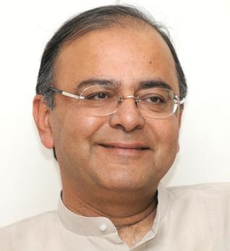
FDI vs FII
Budget-2015
Will eliminate distinction between FDI + FII
Just a composite cap e.g. 49% in defense.
Ease of investment, boost inflow, higher capital account surplus, make in India promoted, jobs, GDP

Slide 7

FDI prohibited in
Lottery
Chit funds, Nidhi fund
Betting, Gambling, Tobacco
Real estate business (townships, malls, shopping complexes, business centres permitted 100%)
Atomic energy.
Railway transport (Metro permit)

Slide 8
FDI 100% Permitted (Automatic)
Agriculture (Tea- Government route)
Mining, coal
Selected real estate
Oil gas exploration
Airport Greenfield, helicopter, Courier
Pharma Green field
Housing, industrial parks
Wholesale trade
Single brand Retail (auto-49%)
Telecom services
E-commerce (B2B)
NBFC

Slide 9
74%
51%
Private Banks (49)
DTH, Mobile TV (49)
Satellites
Multibrand Retail (Govt. route)
Min. 100 million$
Min. 50% in backend infra
30% procurement from Indian MSME
Malls in cities with 10 lakh pop.
Only selected states /UT approved

Slide 10
49%
Defense
Insurance (26% => 49% FDI + FPI combined). Hopeful of getting ~8 billion$
Petro refining
Private security
Commodity exchange
Power exchange
Notes:
The proposed hike in foreign investment limit to 49 per cent in the insurance sector has potential to attract up to USD 7-8 billion (about Rs 50,000 crore) from overseas investors, giving a major boost to the segment.
The total capital deployed in the private life insurance sector is close to Rs 35,000 crore. At FDI at 26 per cent, foreign equity is close to Rs 8,700 crore.
The Insurance Laws Amendment Bill, 2008 could not be taken up for discussion despite being approved by the Select Committee of the Upper House because of the uproar by opposition parties over the conversion and other issues.
The government has blamed political obstructionism for the disruption of Rajya Sabha, where the ruling NDA does not have a majority.
There are 52 insurance companies operating in India, of which 24 are in the life insurance business and 28 in general insurance business. In addition, GIC is the sole national reinsurer.

Slide 11
26%
20%
Print media. (although scientific journals – 100%)
Insurance
defense
Public sector banks
Public sector Banks (FDI + FII combined 20%)

Slide 12
Prelims: FIPB has following:
Economic Affairs (Chairman)
DIPP (policy-promotion)
Dept. Commerce
Economic relations (MEA)
Experts/Officials when required

Slide 13
Foreign investment promotion board FIPB (Secretary)
FIPB = Government approval, under Department of economic affairs, FINMIN.
Upto 1200 cr.=> FIPB=>finmin clears.
Beyond 1200 Cr => cabinet Committee on Economic affairs clears.

Slide 14

Capital Account: L3/P1, P2

Slide 15
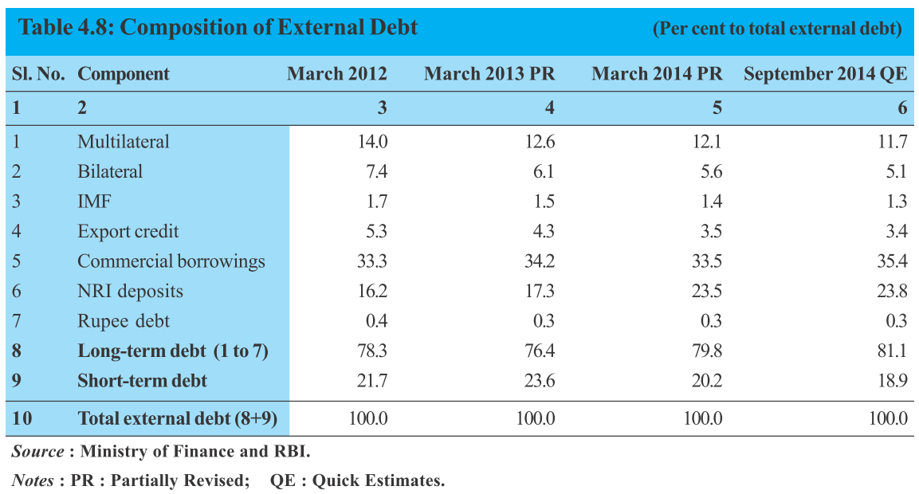
External Debt: GDP= ~24% (manageable limits)

Slide 16
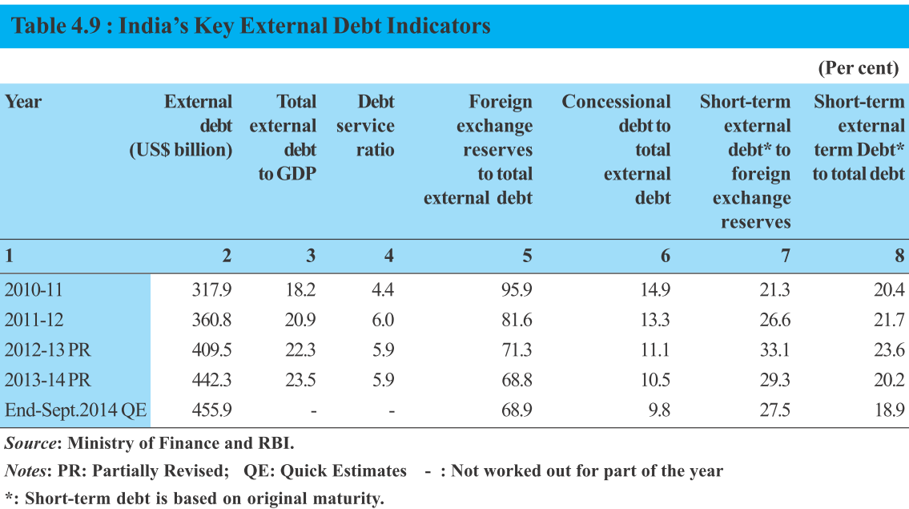
External Debt

Slide 17
Rankings for prelims
External Debt
Source Top 3: Commercial Borrowing > NRI deposits> Multilateral banks.
Composition of Debt: $$ > Rupee > SDR > Yen > Euro
Long term debt > Short term
Non-Governmental debt > Governmental Debt
Increased from March 2013 to 2014

Slide 18
Capital Account: L3/P1 and L3/P2
FDI/FII
Difference abolished
FT/QE
Impact on Indian Economy
GIFT city
Features
Various limits
FIPB
Meaning
Forex Reserve
China ~4 trill, how?
India target 750 bn.
challenges

Slide 19
QE, FT & Exchange rate fluctuations
[GS2] Effect of policies and politics of developed and developing countries on India’s interests
1st world’s low-interest rate policies and quantitative easing, are unleashing financial turmoil on emerging-market economies. Discuss in context of India

Slide 20

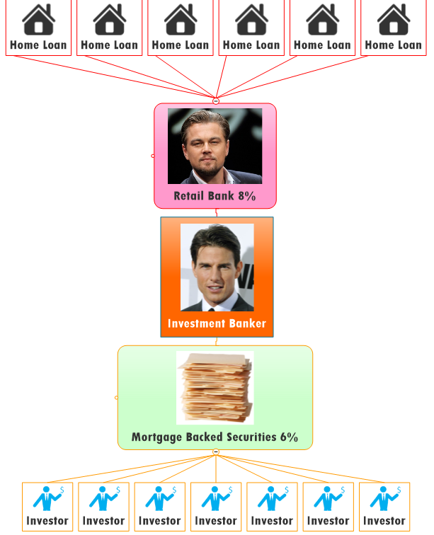


SUBPRIME BORROWERS
SUBPRIME BORROWERS
TOXIC Assets
TOXIC Assets

Slide 21

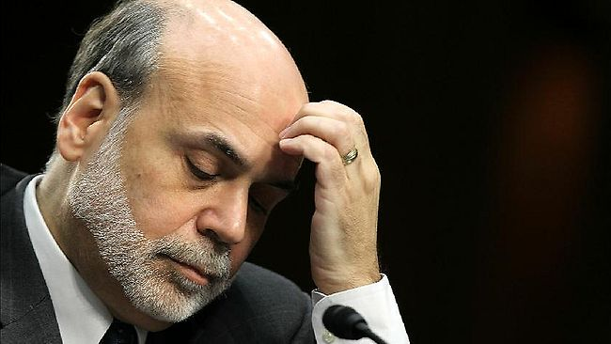


US Fed Reserve
Ben Bernanke
85 Billion $ per month (Dec ‘13)
Treasury bonds and Toxic Assets
Notes:
In March, the ECB and national central banks of euro zone member states will start buying 60 billion euros of chiefly government debt each month. That figure includes rebundled private debt, asset-backed securities and covered bonds, typically worth about 10 billion euros, on top of the roughly 50 billion euros in state bonds. The plan is to buy until September 2016 or until there has been a "sustained" improvement in consumer price inflation, which recently turned negative. The programme could end earlier if successful, or be extended if its impact is small.
http://www.smh.com.au/business/markets/qe-explained-how-the-ecbs-quantitative-easing-plan-will-work-20150123-12wdji.html

Slide 22
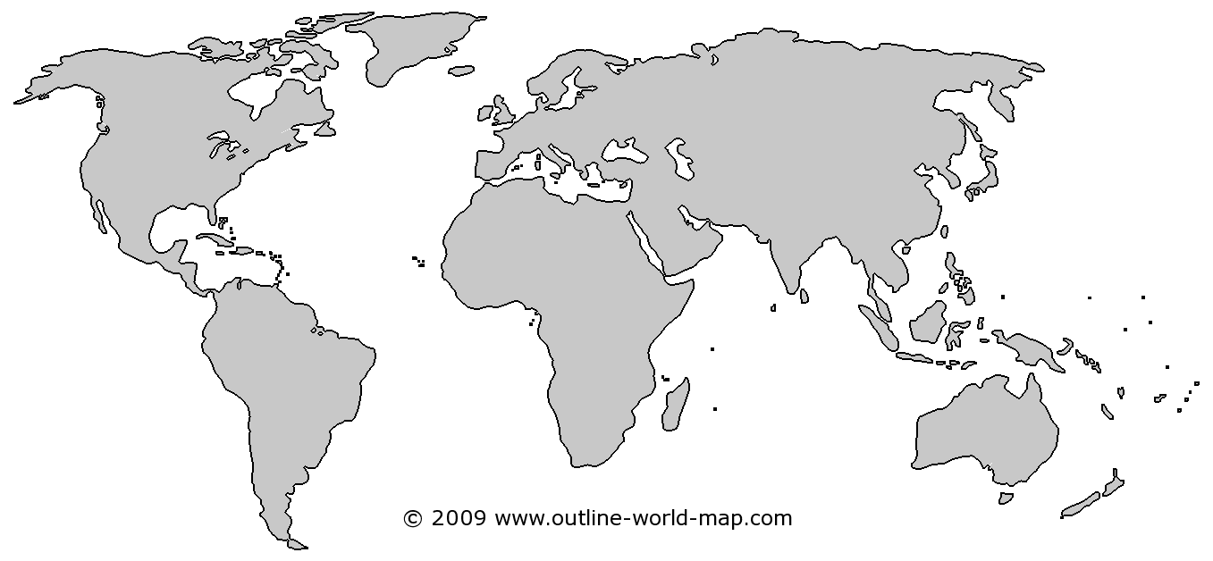


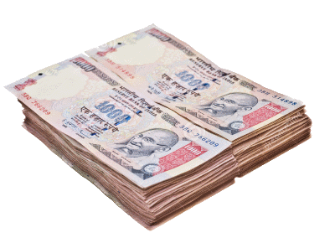
QE: Bond purchase by US Feds=new $$ generated
RBI weapons?
Lib. Remi. Scheme (L3/P2)
FEMA: restriction on Convertibility
$$ weak | Rs. Strong
$1=Rs.39
Good 4imports | Bad 4exports
Notes:
from >100 per barrel to <50$
China, EU Growth▼=oil demand ▼
US oil + shale gas production ▲
OPEC oligopoly ▼, S.Arabia did not ▼ production
Survey predicts: $60-65 / barrel, so, inflation and CAD will be moderate for 2015-16

Slide 23
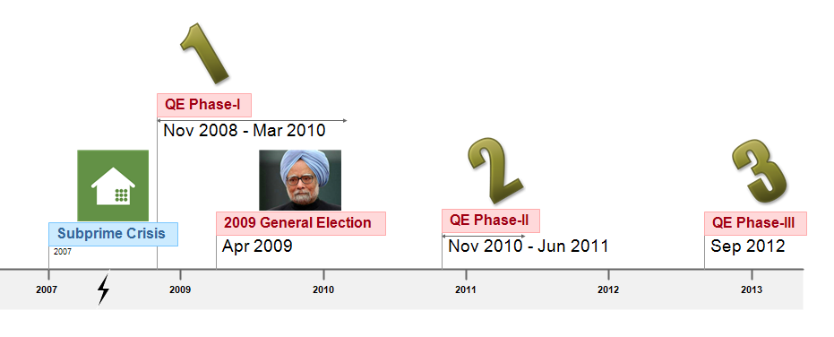
When to stop QE?
Inflation >2.5%
Unemployment <6.5%

Slide 24
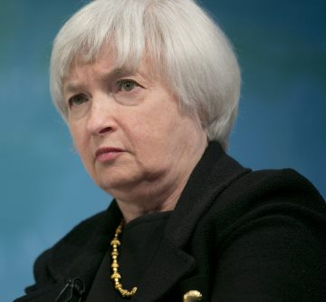
FT: Bond purchase reduced = Less $$ generated
$$ strong | Rs. weak
$1=Rs.60+
Bad 4imports | Good 4exports
Notes:
from >100 per barrel to <50$
China, EU Growth▼=oil demand ▼
US oil + shale gas production ▲
OPEC oligopoly ▼, S.Arabia did not ▼ production
Survey predicts: $60-65 / barrel, so, inflation and CAD will be moderate for 2015-16

Slide 25
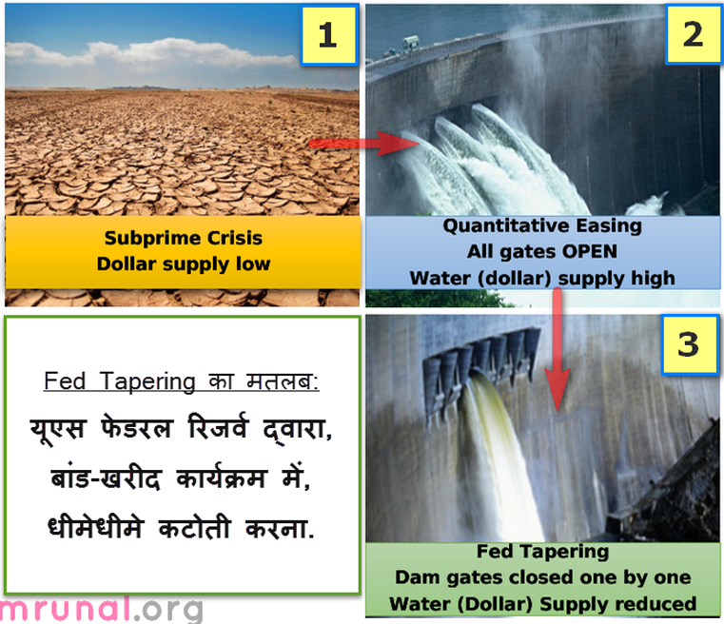
▲dollar supply
strong rupee
Weak dollar
▼ dollar supply
strong dollar
Weak rupee

Slide 26
Fed Tapering: ended @Oct’14, @15 Billion purchase
mechanical term= Continuous reduction of width.
June 2014
Bonds: 20bn
Toxic MBS: 15bn
=======
Total 35

Slide 27
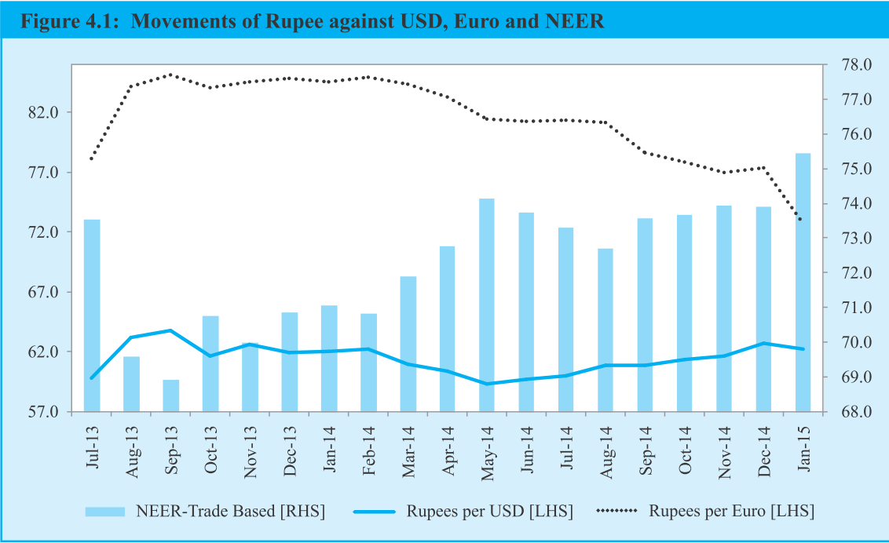
Dollar outflow => weakening of rupee but RBI intervention stabilized it
FT started here though but RBI prevents downfall by market intervention
Rumors of Fed tapering

Slide 28
Fighting FT: India had to stop OUTFLOW of dollars
$$ strong | Rs. weak
$1=Rs.60+
Bad 4imports | Good 4exports
Notes:
from >100 per barrel to <50$
China, EU Growth▼=oil demand ▼
US oil + shale gas production ▲
OPEC oligopoly ▼, S.Arabia did not ▼ production
Survey predicts: $60-65 / barrel, so, inflation and CAD will be moderate for 2015-16

Slide 29

To stop weakening
Of Rupee
$1=70Rs.
After stability,
Liberalized remittances scheme relaxed
$1.25 lakh (2014, June)
$2.5 lakh (2015, Feb)
Stop $$ outflow
FEMA tight
LRS Tight: $75,000 (2013)

Slide 30



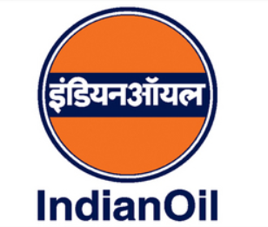
Fighting FT: India had to stop OUTFLOW of dollars
Restriction on gold import
10% duty, 80:20 rule
RBI’s Special window for OMC to purchase Repay @$$ later date.
Result? Volatility in forex market ▼
Notes:
from >100 per barrel to <50$
China, EU Growth▼=oil demand ▼
US oil + shale gas production ▲
OPEC oligopoly ▼, S.Arabia did not ▼ production
Survey predicts: $60-65 / barrel, so, inflation and CAD will be moderate for 2015-16

Slide 31
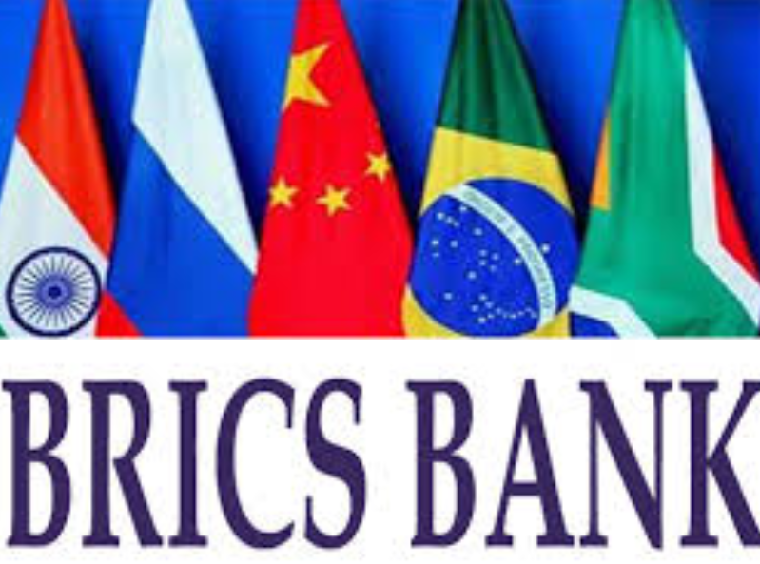

Fighting FT: India had2 augment FOREX reserve
$100 bn. Contingency fund
Current swap
agreement
With Japan & others
Notes:
from >100 per barrel to <50$
China, EU Growth▼=oil demand ▼
US oil + shale gas production ▲
OPEC oligopoly ▼, S.Arabia did not ▼ production
Survey predicts: $60-65 / barrel, so, inflation and CAD will be moderate for 2015-16

Slide 32
Fed Tapering: $$ supply low=> Rupee weaken, bad for imports
UPA-II end days- faster environment clearance to POSCO etc. to attract FDI
Crude oil prices fell: CAD declined

Slide 33

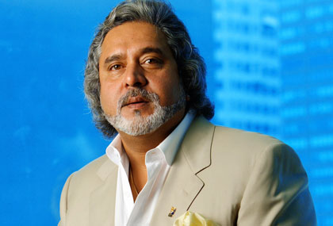
US Fed Rate “Cut”: $ weak, Rs. Strong
US Fed rate
2%=0.5%
RBI Repo Rate
8%
Cheap for me to borrow from USA, invest in India
Expensive
4me ☹
Notes:
from >100 per barrel to <50$
China, EU Growth▼=oil demand ▼
US oil + shale gas production ▲
OPEC oligopoly ▼, S.Arabia did not ▼ production
Survey predicts: $60-65 / barrel, so, inflation and CAD will be moderate for 2015-16

Slide 34
US Fed Rate “Hike” (Expected in June 2015)
US Fed rate
0.5%=2%
RBI Repo Rate
8%=>7.5%
(Relatively) Expensive 4me ☹
Better pull out $$
from India & invest
where return is higher
(Relatively) Cheap
for me to borrow
& invest in India ☺
Notes:
from >100 per barrel to <50$
China, EU Growth▼=oil demand ▼
US oil + shale gas production ▲
OPEC oligopoly ▼, S.Arabia did not ▼ production
Survey predicts: $60-65 / barrel, so, inflation and CAD will be moderate for 2015-16

Slide 35
Fed Rate hike= $$ outflow from India ▲
$$ strong | Rs. weak
$1=Rs.65+
Bad 4imports | Good 4exports
Notes:
from >100 per barrel to <50$
China, EU Growth▼=oil demand ▼
US oil + shale gas production ▲
OPEC oligopoly ▼, S.Arabia did not ▼ production
Survey predicts: $60-65 / barrel, so, inflation and CAD will be moderate for 2015-16

Slide 36
Dangerous to approach full Cap.AC these days
QE
Bad for exports
FT/Rate hike
Bad for imports
Flight of capital
Rupee weak
Strong Rupee
FII hot money- Inflation
RBI hv2 sell $$
RBI hv2 buy $$

Slide 37
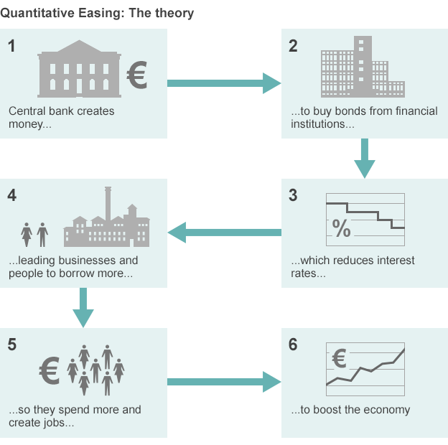
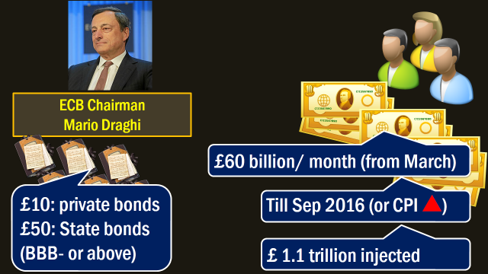
Ref: L3/P3 ECB Quantitative Easing

Slide 38
Mains/Interview
1st world’s low-interest rate policies and quantitative easing, are unleashing financial turmoil on emerging-market economies. Discuss in context of India. (Rajan)
QE= strong rupee…bad for exports
Followed by FT/rate hike= weak rupee…bad for imports
Stability in foreign trade…X
Trade deficit, CAD, inflation, unemployment, BOP crisis

Slide 39
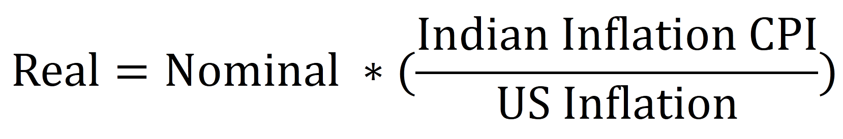
Only for prelims: L3/P2.pptx: Real exchange rate
6 currencies
Weighed Geometric mean
REER-6
REER-36

Slide 40
L3/P2.pptx REER
REER-36
Basket of 36 currencies
Geometric mean (wt. assigned to a foreign currency as per trade importance with India)
REER > 100 means overvalued currency
▲REER = ▼ Trade competitiveness

Slide 41
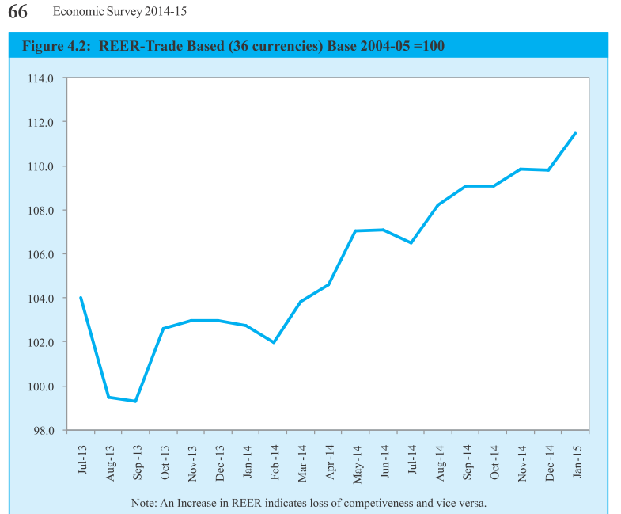
▲REER = ▼ Trade competitiveness
FT rumors+inflation
Same period when $1 went from 55 to 64 Rs.

Slide 42
Capital Account: L3/P1 and L3/P2
FDI/FII
Difference abolished
FT/QE
Impact on Indian Economy
GIFT city
Features
Various limits
FIPB
Meaning
Forex Reserve
China ~4 trill, how?
India target 750 bn.
challenges

Slide 43
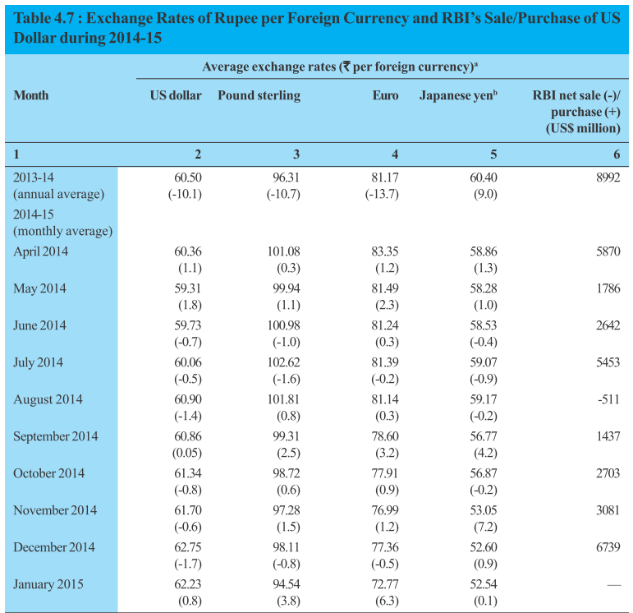
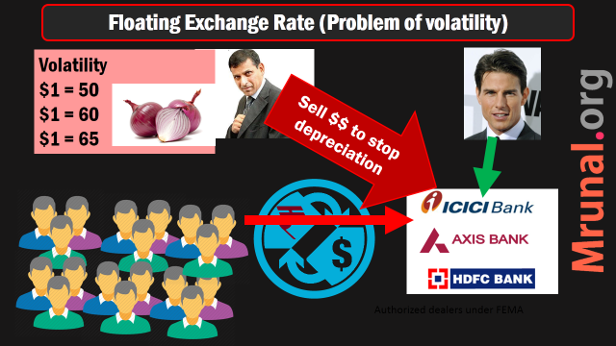
Managed “Floating” Exchange rate regime
RBI Buy $ to stop appreciation of Rupee
Sell $ to stop depreciation of Rupee
Ref: L3/P2.pptx

Slide 44
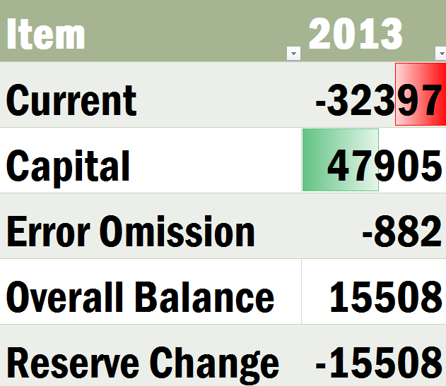
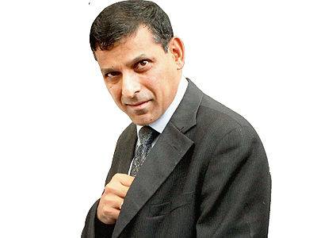
If BoP surplus- RBI should purchase those $$ (Mill.USD)
Balance of Payment ZERO

Slide 45
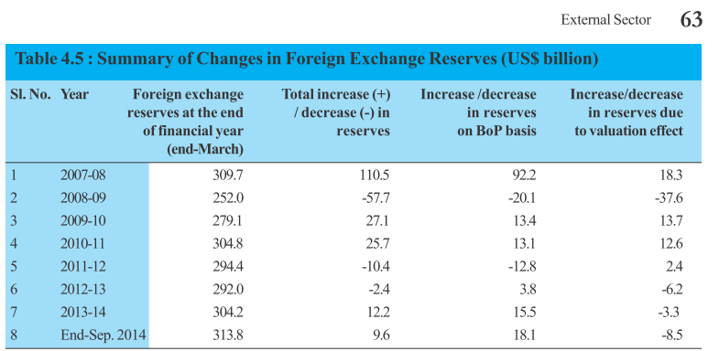
RBI Forex reserve Gradually augmented

Slide 46
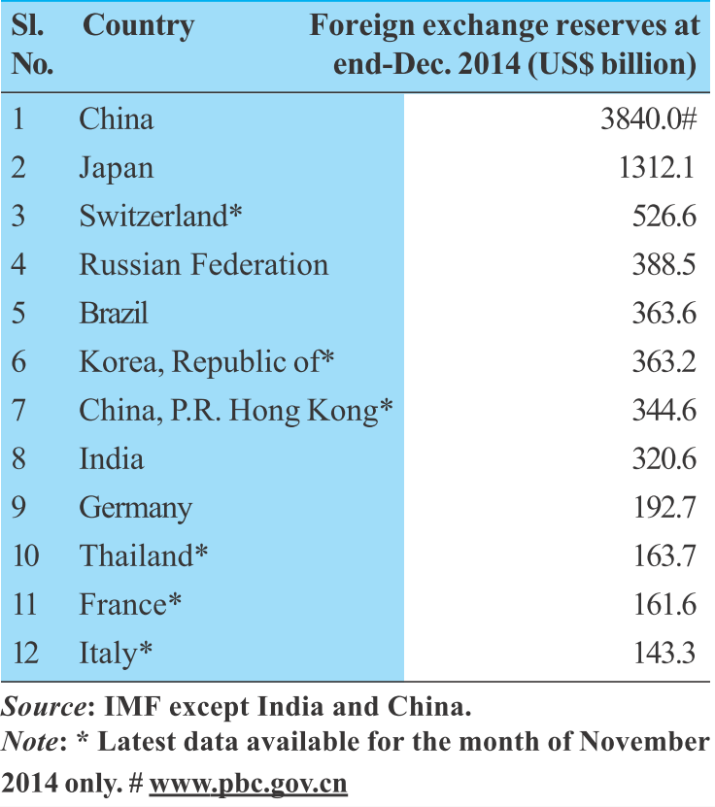
India’s Forex components: Foreign currency, Gold, SDR, Reserve Tranche Position (RTP)
Among the major economies with current account deficit, India is the second largest foreign exchange reserve holder after Brazil

Slide 47
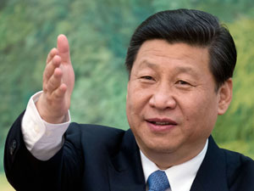
China ~4 trillion$ HOW?
Forex reserve
Chinese “Mercantile Policy”
Imports restrained (L6/P1.pptx)
IT: SOE control market
Pharma: inordinate delay in clearance
Food: SPS agreement.
MFG: domestic too cheap
Exports promoted: SOE get cheap loans, subsidies, tech-piracy neglected; coal-steel-rare earth, Labour abuse.

Slide 48

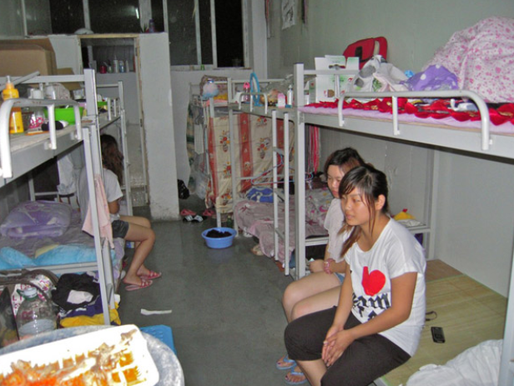
Child labors in bubble wrap factory
Bunk beds in Motorola co.
Double shift, pay rent

Slide 49
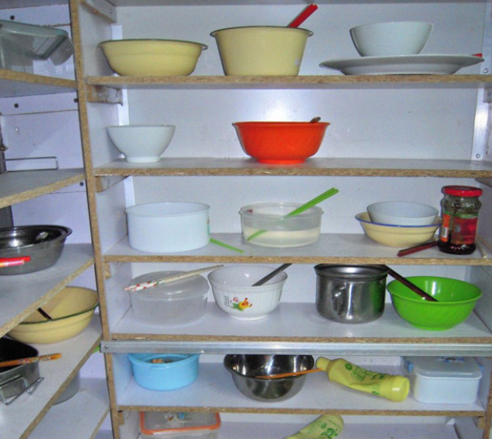
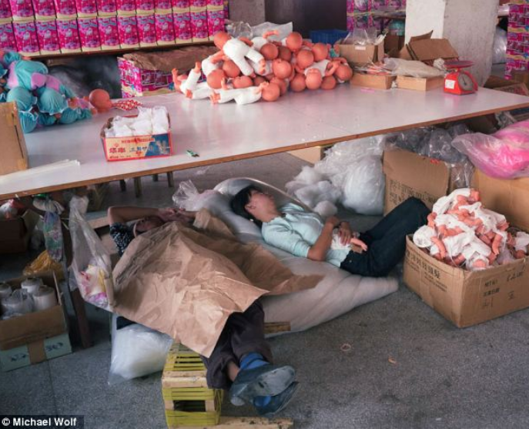
Bring ur own bowls in canteen, pay for food
75% of world toys, 35 lakh employed, 10 lakh injured (‘09)
No social security

Slide 50
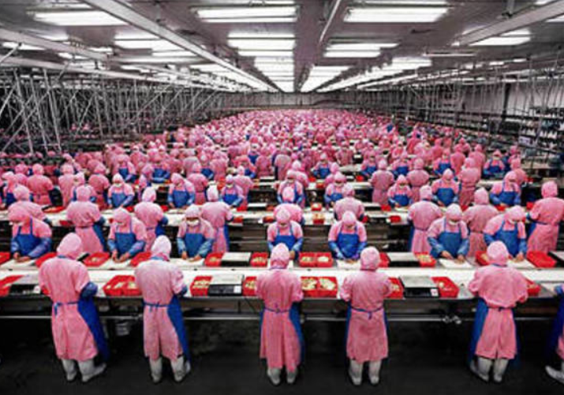
Labour abuse
China
Foxconn- iphone maker company, Henan province. >2 lakh migrants
Toilet break “need written permit” from foreman
Overtime usually not given. ~15 hrs a day
Monthly salary: ~$250, but nothing left to send @home.
But for company, labour cost minimal.

Slide 51
China leads in exports: how?
Cost of production low (environment / labour abuse, Piracy)
Undervalued yuan

Slide 52

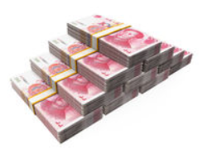
In a free market economy with no intervention
$1 =6 Yuan
Eventually
$1 = 1 Yuan
$1= 0.5 Yuan
….

Slide 53
But China keeps yuan undervalued, HOW?
$$ shortage in
Chinese Forex market
$1 = 6 Yuan
Good for exports
Keep printing Yuan
Keep investing incoming $$ back to US treasury bonds

Slide 54
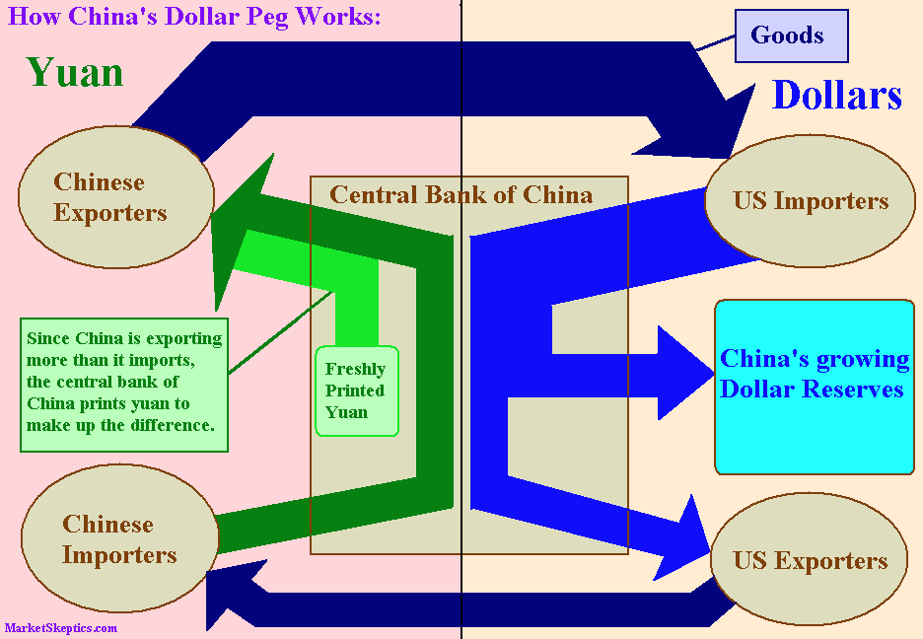
Notes:
The little discussed downside of the dollar peg is all the money China has to print to maintain it. China's Central Bank puts the extra dollars it receives from its trade surplus into its growing foreign reserves and then prints yuan to pay Chinese exporters. This results in an increase in China's base money supply by an amount equal to the increase in its foreign exchange reserves. While China's ability to keep accumulating US reserves is endless, its ability to keep its money supply under control is not.
If there is one development which could force China to drop its dollar peg, it is out of control inflation. Rampant inflation would result in millions of citizens starving and would create widespread social unrest. Keeping food prices low is a matter of political survival for Chinese authorities. So, facing the choice between losing their grip on power and losing the dollar peg, they will not hesitate for a second to sacrifice the dollar to save their own skin.

Slide 55
China’s Balance of Payment (2014)
Export (labor, undervalued yuan)
Import: restrained (IT/Pharma)
US bond purchase
(-)
Remi. 2nd largest
Current Account surplus (+210 Bn)
Capital Acc. DEFICIT -96 Bn.

Slide 56
BoP has to be ZERO
Current Account surplus +210 Bn
Capital Acct. DEFICIT: -96 Bn.
NET: +114 Billion
Reserve change
BoP = 0

Slide 57
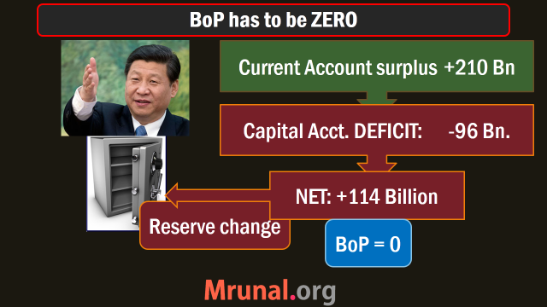
China’s Forex reserve: ~3840 billion
+ People’s bank of China keeps buying $$ to stop yuan from appreciating.
$$ accumulation = forex build up.

Slide 58
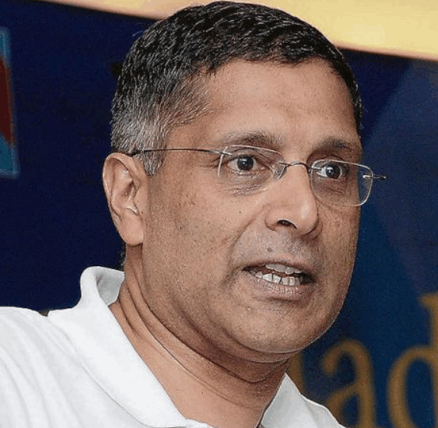
Large forex reserve bad bcoz
Forex reserve
Chinese Mercantilism Policy: restrain imports, boost exports, buy $$ to keep Yuan weak = large forex reserve.
But subsequent distortion of financial and exchange market may hurt China during crisis (e.g. another QE / slowdown in US or EU market, TATIP, TPP)
IF $$ weak, hv2 print more yuan to get $$ stronger=> DOMESTIC hyperinflation in China

Slide 59
Large forex reserve good bcoz
Forex reserve
Geo-strategic advantage
(1) hard power (2) soft power
Even helping other nations facing financial crisis (Soft power)
+ providing bilateral assistance (BRICS + AIIB + silk road/belt)
India too should target $750 billion to $1 trillion in long run via current account surplus.

Slide 60

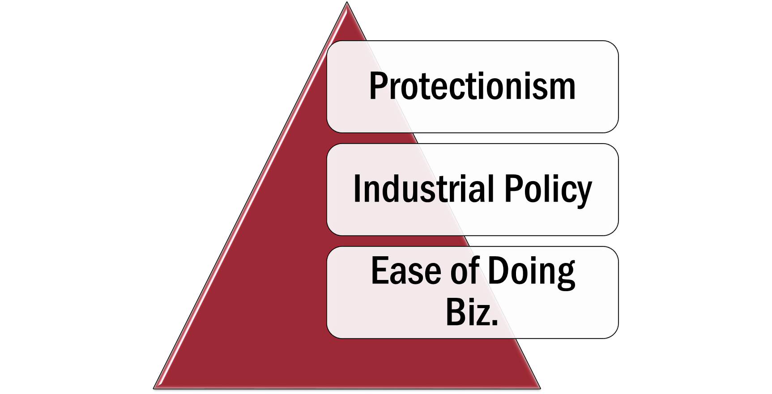

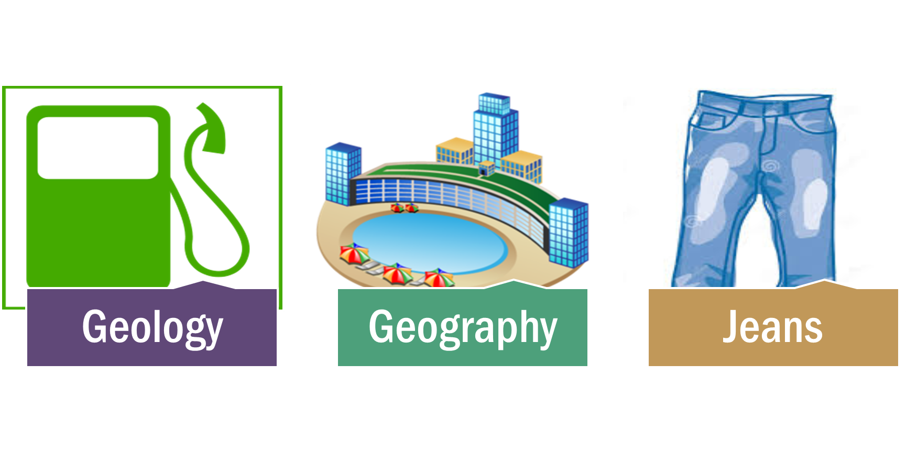
DEFICIT
SURPLUS
DEFICIT
SURPLUS
Current Account deficit

Slide 61
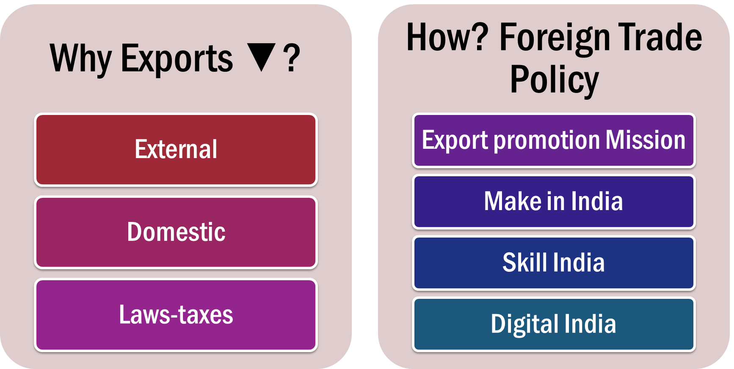
DEFICIT
SURPLUS
DEFICIT
SURPLUS
Current Account deficit

Slide 62

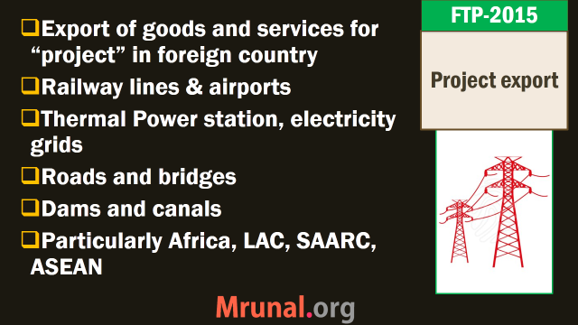
SURPLUS
FOREX reserve: >$750 bn
SURPLUS
DEFICIT
SURPLUS
Current Account SURPLUS

Slide 63
Capital Account: L3/P1 and L3/P2
FDI/FII
Difference abolished
FT/QE
Impact on Indian Economy
GIFT city
Features
Various limits
FIPB
Meaning
Forex Reserve
China ~4 trill, how?
India target 750 bn.
challenges

Slide 64
Possible questions in UPSC
Prelims: owners, location, features, rules
GS3: Vibrant financial markets are critical to a country’s GDP growth. Examine the importance of proposed GIFT city in this regard, & discuss challenges in its setup. 200 words

Slide 65
London, NY and Singapore 3 biggest Intl. Fin. Centre
Dubai
Notes:
from >100 per barrel to <50$
China, EU Growth▼=oil demand ▼
US oil + shale gas production ▲
OPEC oligopoly ▼, S.Arabia did not ▼ production
Survey predicts: $60-65 / barrel, so, inflation and CAD will be moderate for 2015-16

Slide 66


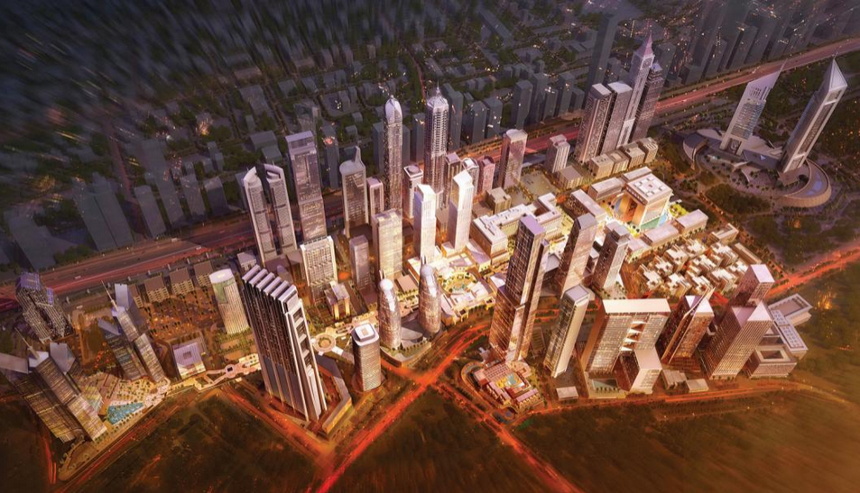
Dubai international financial centre

Slide 67
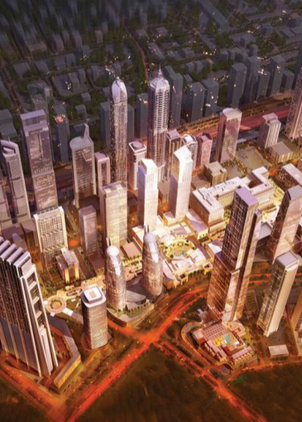
DUBAI better how?
DIFC
0% tax on income & profit for 50 years! India unclear.
DTAA with most nations.
100% FDI and ownership in everything. (India: some restriction on stock exchange/insurance cos.)
Full capital AC. Convertibility – invest and pull out money in currency of your choice.

Slide 68
DUBAI better how?
DIFC
Independent judicial system, complying with 1st world laws.
high speed net, transport.
Skilled professionals, quick visa processing and work permits in single window.
Art galleries, restaurant, fashion, vibrant social /club life, apartments, hotels

Slide 69
??
some
incoming

Slide 70
Gujarat Intl. Financial Tech City: JV between
GIFT ltd.
ILFS
Central India Bank
Guj.Urban Dvlp co. ltd
UTI, LIC
SBI, HDFC
Infrastructure Leasing & Financial Services Limited

Slide 71
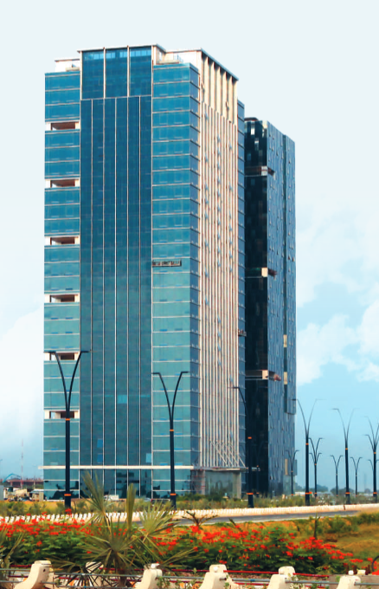
Place
GIFT City
“Greenfield” business city in Gandhinagar district
Smart city = automated waste collection system, centralised cooling, civic amnesties using ICT
Main attraction – diamond tower of 88 storey
Budget-2015: will promote GIFT city as intl.financial service centre (IFSC)

Slide 72
GIFT city Financial SEZ: 2 set of rules
DESI
Already present: SEBI, IRDA, RBI
Intl. financial services centre (IFSC)
SEBI
RBI (Cap.AC)
IRDA

Slide 73
guidelines
GIFT City
All investors /operators are “non-resident Indians outside India” for tax purpose
Invest in Hedge fund (Alternate investment fund) and mutual funds BUT in foreign currency only (L2/P1)
Merchant bank, Depository receipts, stock exchange…yes but norms on min.capital etc.
NSE will setup international exchange for trading of shares, bonds, currencies and derivatives

Slide 74
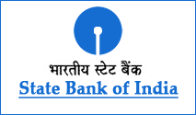
IFSC banking unit (IBU)
GIFT City
Foreign banks can setup unit yes
Indian banks with foreign presence, can setup units…yes
Each bank can setup only 1 IBU
Retail customer? Can’t take
Rupee deposits? Can’t take
CRR, SLR applicable? yes.
Must have $20 mil. Capital to begin

Slide 75
challenges
GIFT City
India’s CRR, SLR requirements high than 1st world IFSCs
BUT, Full capital account convertibility needed.
Only then IFSC possible, said Percy Mistry Committee (2007)
RBI Dy.Gov exploring relaxing Cap.AC (2015)
Ref: L3/P2.pptx for Pros and Cons.

Slide 76
Legal challenges
GIFT City
GST yet to implement. (service tax?)
Modify IT act to give 0% tax on income, profit, capital gains for 40-50 years? What if regime change?
Hv2 Abolish existing acts

Slide 77
Legal challenges
GIFT City
Alternate dispute resolution system needed.
Percy Mistry : Unified Financial Modernization Act
FSLRC – BN Shrikrishna committee recommended – Indian financial code (IFC) Ref: L2/P2.pptx

Slide 78
Benefits
GIFT City
Model for smart city
“Experimentation” on IFC, Full Cap.AC, before implementing @All India level.
Flight of capital ▼
Knowledgebase from MNC-XP
More white collar jobs
Trickle down in the region (A’bad, G’Nagar: banking/fin./IT/BPO boom) - ~5 lakh jobs

Slide 79
Mains / Interview?
Q: Vibrant financial markets are critical to a country’s GDP growth. Examine the importance of proposed GIFT city in this regard, & discuss challenges in its setup. 200 words
Agrarian Economy=>MFG=>Service
MNC giant HQ, outsource to low skill nations. India too will reach that stage. Need to begin Development now.
No GIFT city = Flight of capital to other IFSC
Yes GIFT city= IBU, investment, jobs, smart city

Slide 80
Capital Account: L3/P1 and L3/P2
FDI/FII
Difference abolished
FT/QE
Impact on Indian Economy
GIFT city
Features
Various limits
FIPB
Meaning
Forex Reserve
China ~4 trill, how?
India target 750 bn.
challenges

Slide 81
